Slide 1
CH2 Time series

Slide 2
Agenda
Overview
Autocorrelation
Time Series Model- White noise
Time Series Model- MA
Time Series Model- AR
Time Series Model- ARMA

Slide 3
Overview
Define :
A time series is a sequence of values measured
over time.
Deterministic time series:
->Derived from a fixed deterministic formula.
Probabilistic or Stochastic time series:
->Obtained by drawing a sample from a probability distribution.
We focus on Probabilistic or Stochastic time series
in this chapter.

Slide 4
Autocorrelation
Is there a relationship between the value now and the value observed one time(even more) step in the past?
The strength of the (linear) relationship is reflected in the correlation number.
The answer to these questions, spanning the entire range of time steps , could very well be the autocorrelation function.

Slide 5
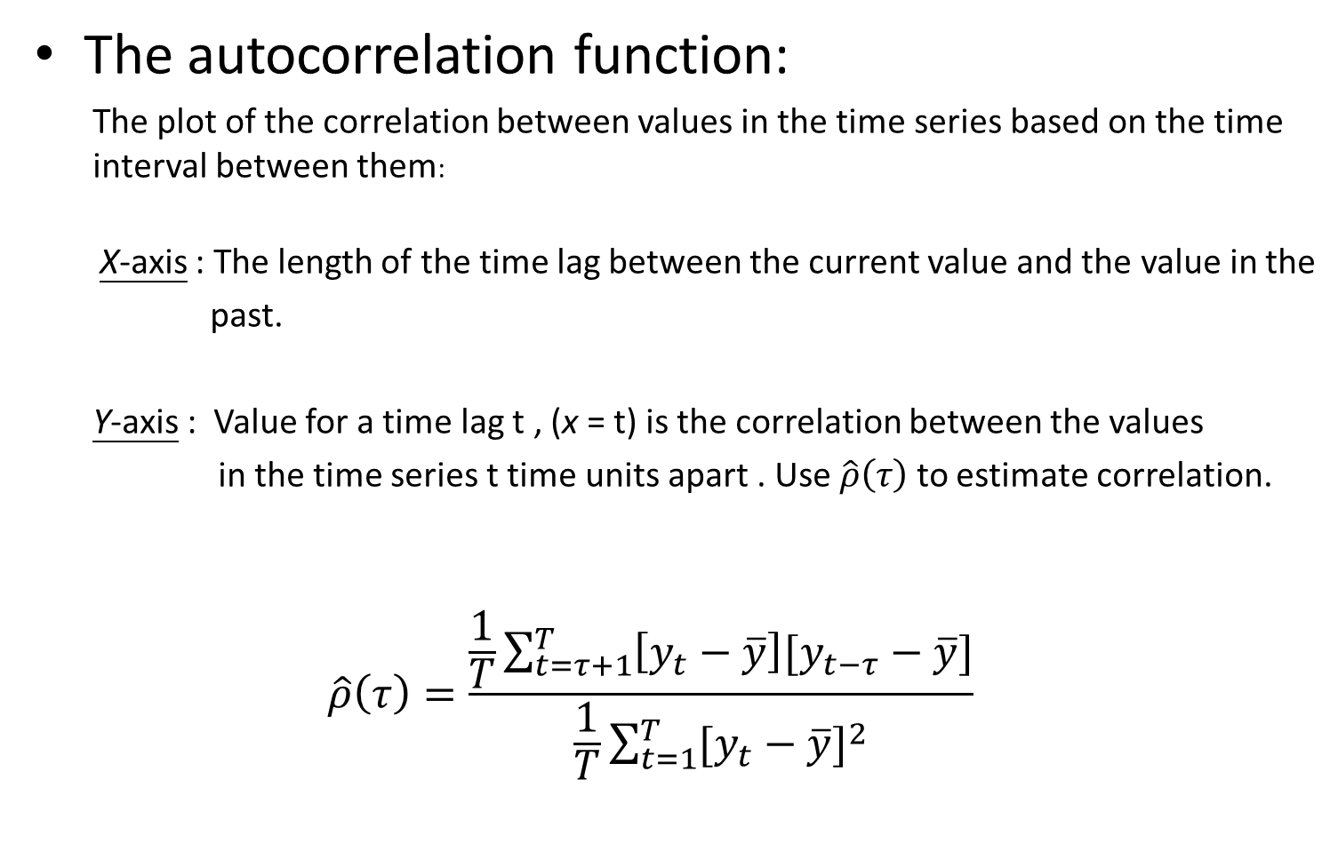
Autocorrelation
The autocorrelation function:
The plot of the correlation between values in the time series based on the time interval between them:
X-axis : The length of the time lag between the current value and the value in the
past.
Y-axis : Value for a time lag t , (x = t) is the correlation between the values
in the time series t time units apart . Use $\hat{ρ}\left(τ\right)$ to estimate correlation.
$$\hat{ρ}\left(τ\right)=\frac{\frac{1}{T}\sum_{t=τ+1}^{T}{\left[y_{t}−\overline{y}\right][y_{t−τ}−\overline{y}]}}{\frac{1}{T}\sum_{t=1}^{T}{{[y_{t}−\overline{y}]}^{2}}}$$

Slide 6
Autocorrelation
Correlogram:
The plot of the estimated correlation against time intervals forms an estimation of the autocorrelation function, called the correlogram.
It serves as a proxy for the autocorrelation function of the time series.

Slide 7
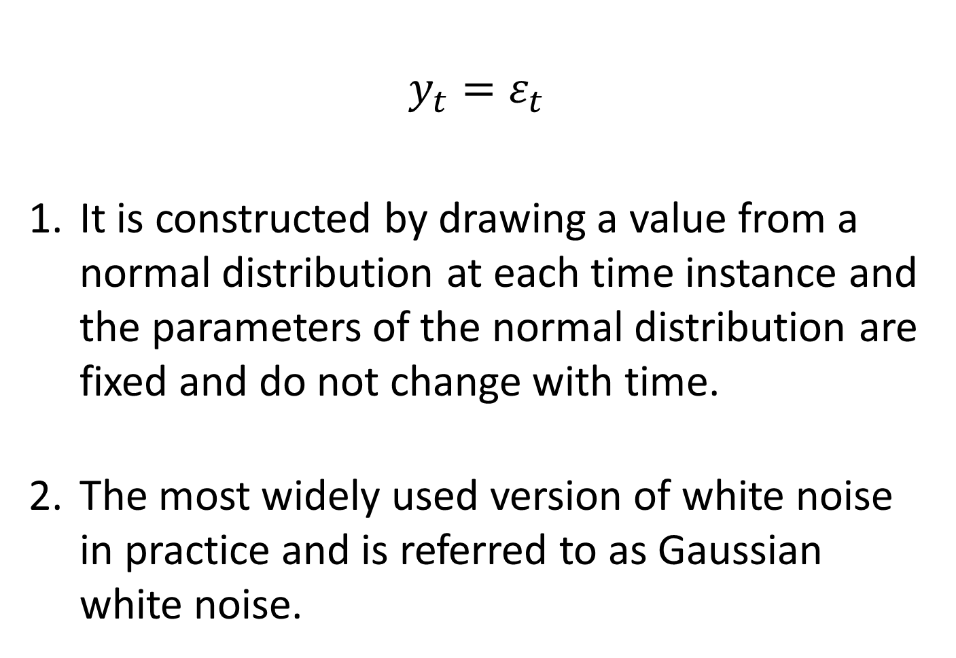
Time Series Model- White Noise
$$y_{t}=ε_{t}$$
It is constructed by drawing a value from a normal distribution at each time instance and the parameters of the normal distribution are fixed and do not change with time.
The most widely used version of white noise in practice and is referred to as Gaussian white noise.

Slide 8
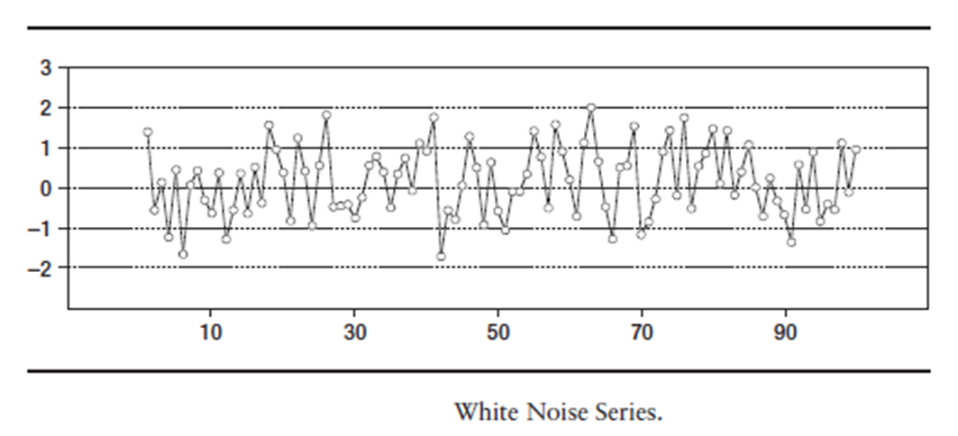
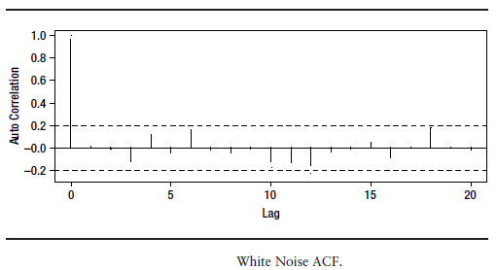
Time Series Model- White Noise
White noise series:

Slide 9
Time Series Model- White Noise
Analysis:
1.

Slide 10
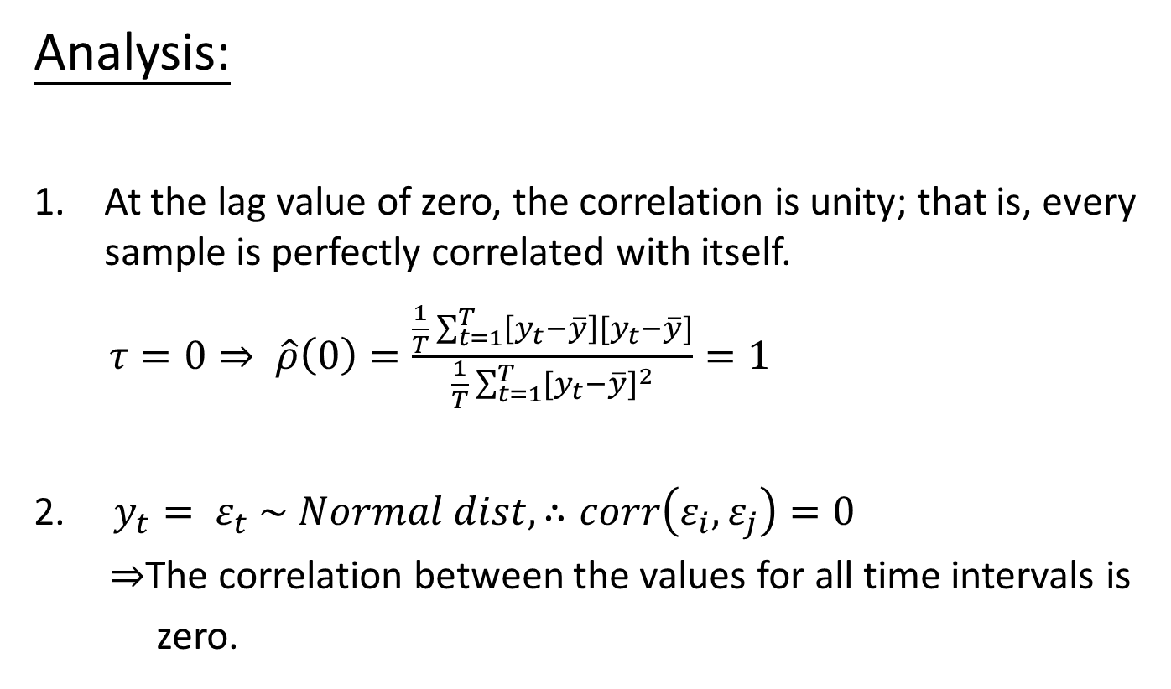
Time Series Model- White Noise
Analysis:
At the lag value of zero, the correlation is unity; that is, every sample is perfectly correlated with itself.
$τ=0⇒ \hat{ρ}\left(0\right)=\frac{\frac{1}{T}\sum_{t=1}^{T}{\left[y_{t}−\overline{y}\right][y_{t}−\overline{y}]}}{\frac{1}{T}\sum_{t=1}^{T}{{[y_{t}−\overline{y}]}^{2}}}=1$
$y_{t}= ε_{t} \sim Normal dist, ∴corr\left(ε_{i},ε_{j}\right)=0$
$⇒$The correlation between the values for all time intervals is
zero.
iid

Slide 11
Time Series Model- White Noise
Question:
Does knowledge of the past realization help in the prediction of the time series value in the next time instant?
Ans :
Past realization can help to estimate the varience of Normal dist. , so we can arrive at some intelligent conclusions about the odds of the next realization of the time series being greater than or less than some value. (like Chebyshev's Inequality)

Slide 12
Time Series Model- White Noise
Summary:
The variance of the value at each point in the series is the variance of the normal distribution used for drawing the white noise values.
This distribution with a specific mean and variance is time invariant. Thus, a white noise series is a sequence of uncorrelated random variables with constant mean and variance.

Slide 13
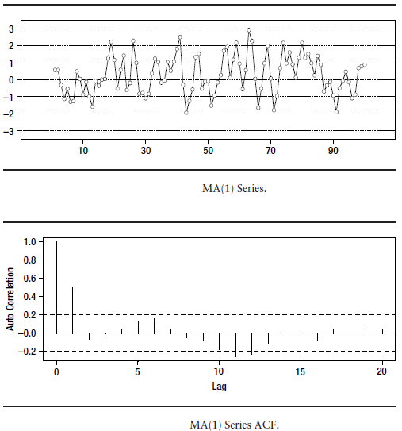

Time Series Model- MA
$y_{t}=ε_{t}+βε_{t−1}$ called MA(1)
MA means moving average . If $β$ = 0 , $y_{t}$ is white noises.
In the correlogram , there is a steep drop in the value after$τ$ = 1.
Why?

Slide 14
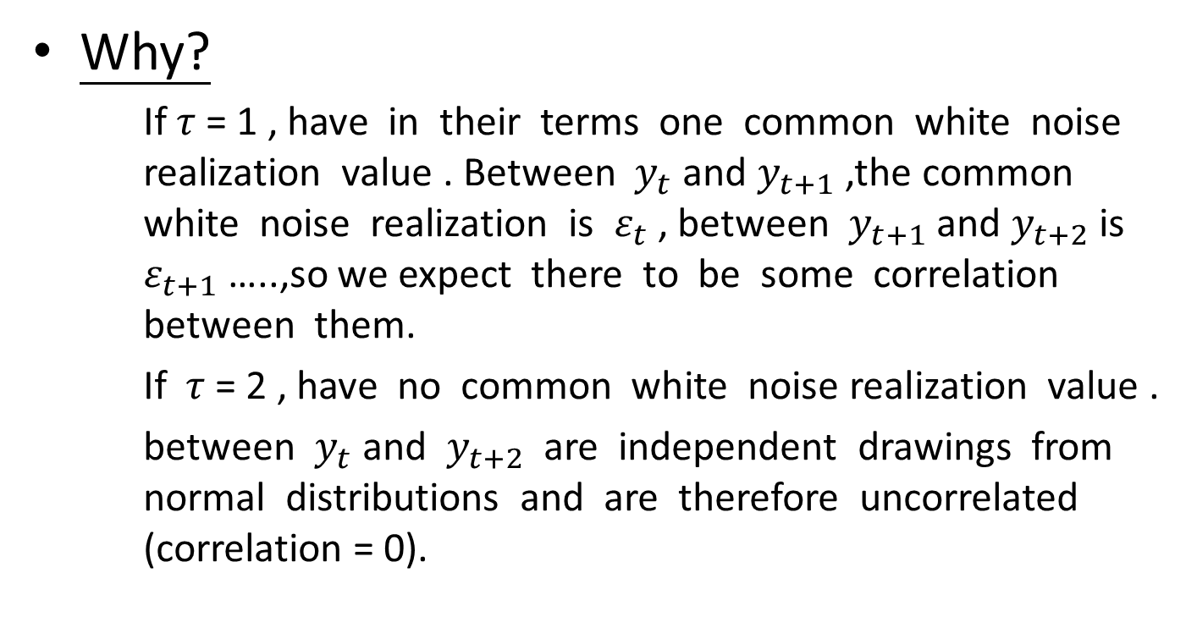
Time Series Model- MA
Why?
If$τ$ = 1 , have in their terms one common white noise realization value . Between $y_{t}$ and $y_{t+1}$ ,the common white noise realization is $ε_{t}$ , between $y_{t+1}$ and $y_{t+2}$is $ε_{t+1}$ …..,so we expect there to be some correlation between them.
If$τ$ = 2 , have no common white noise realization value .
between $y_{t}$ and $y_{t+2}$ are independent drawings from normal distributions and are therefore uncorrelated (correlation = 0).

Slide 15
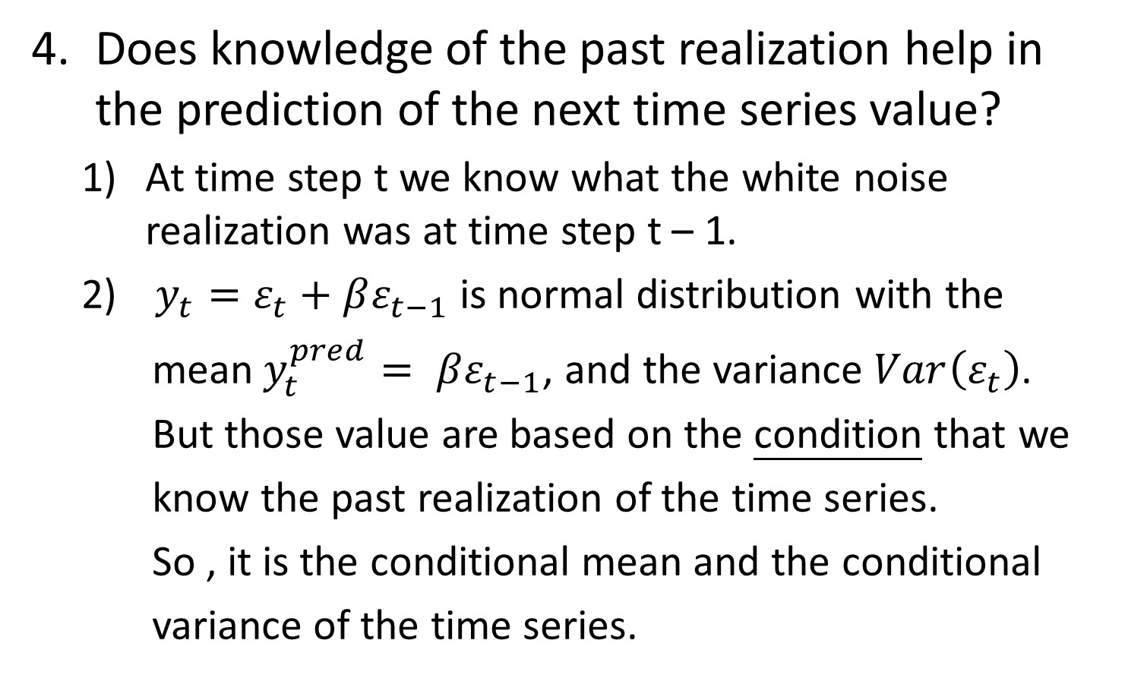
Time Series Model- MA
Does knowledge of the past realization help in the prediction of the next time series value?
At time step t we know what the white noise realization was at time step t – 1.
$y_{t}=ε_{t}+βε_{t−1}$ is normal distribution with the
mean$y_{t}^{pred}= βε_{t−1}$, and the variance $Var\left(ε_{t}\right)$.
But those value are based on the condition that we
know the past realization of the time series.
So , it is the conditional mean and the conditional
variance of the time series.

Slide 16
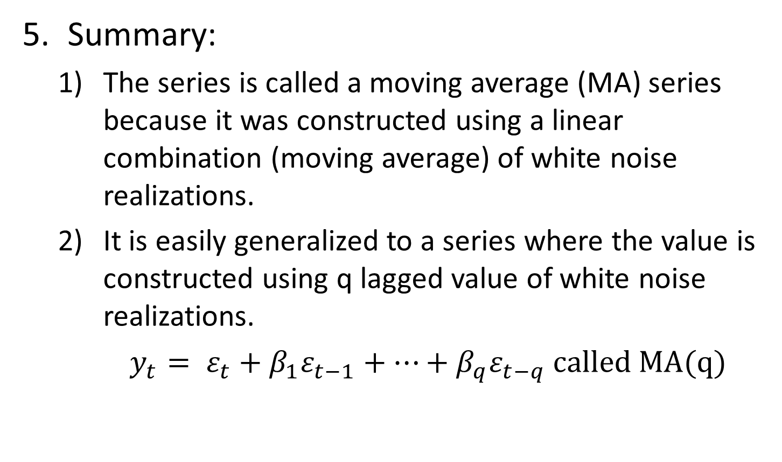
Time Series Model- MA
Summary:
The series is called a moving average (MA) series because it was constructed using a linear combination (moving average) of white noise realizations.
It is easily generalized to a series where the value is constructed using q lagged value of white noise realizations.
$y_{t}= ε_{t}+β_{1}ε_{t−1}+…+β_{q}ε_{t−q} called MA(q)$

Slide 17
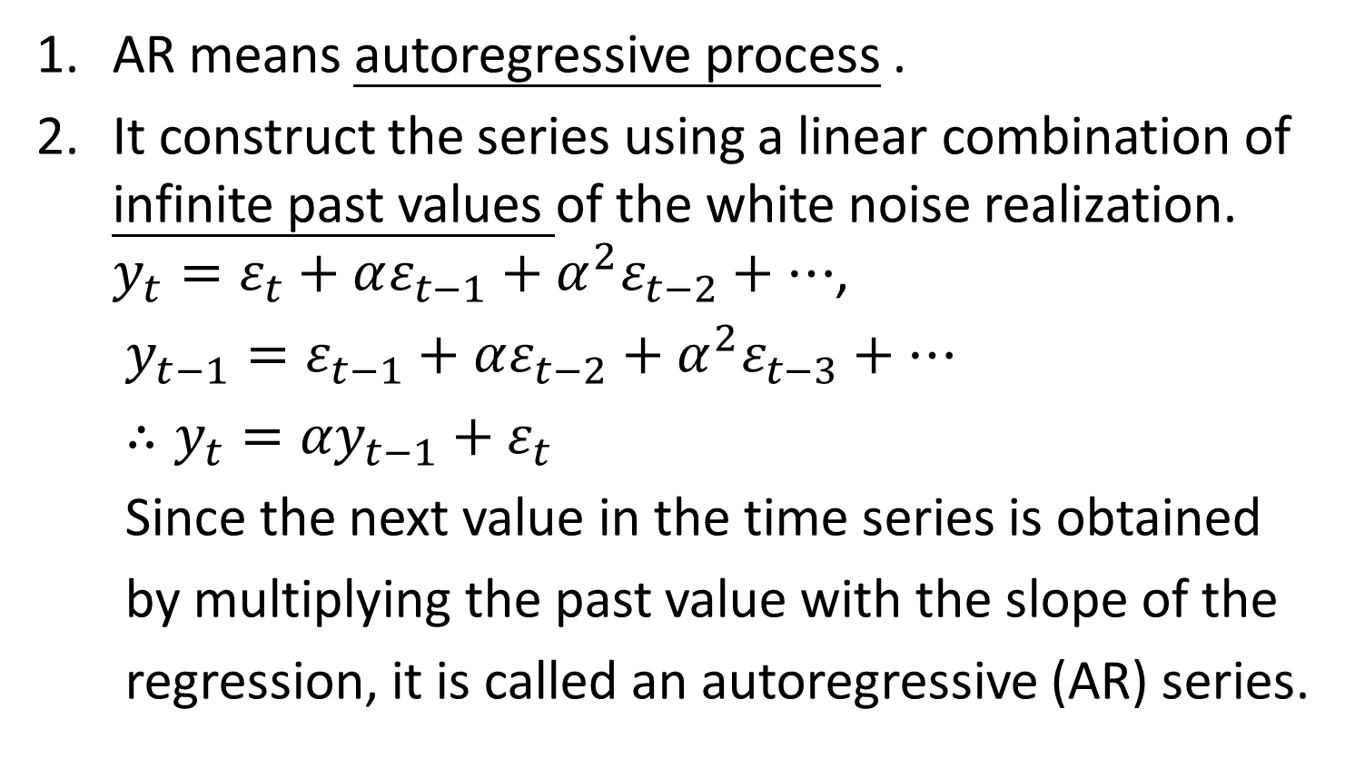
Time Series Model- AR
AR means autoregressive process .
It construct the series using a linear combination of infinite past values of the white noise realization. $y_{t}=ε_{t}+αε_{t−1}+α^{2}ε_{t−2}+…$,
$y_{t−1}=ε_{t−1}+αε_{t−2}+α^{2}ε_{t−3}+…$
$∴y_{t}={αy}_{t−1}+ε_{t}$
Since the next value in the time series is obtained
by multiplying the past value with the slope of the
regression, it is called an autoregressive (AR) series.

Slide 18
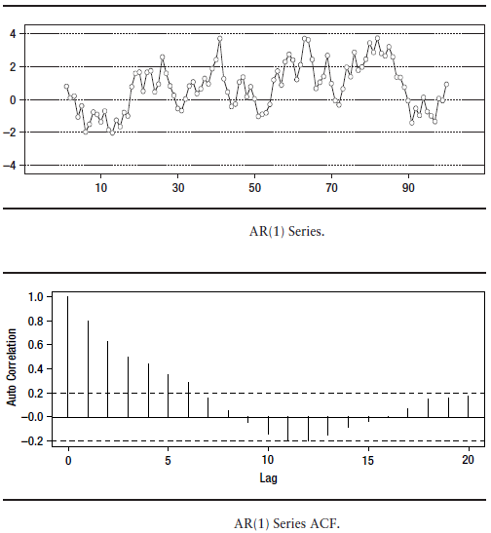
Time Series Model- AR
The correlation values fall off gradually with increasing lag values

Slide 19
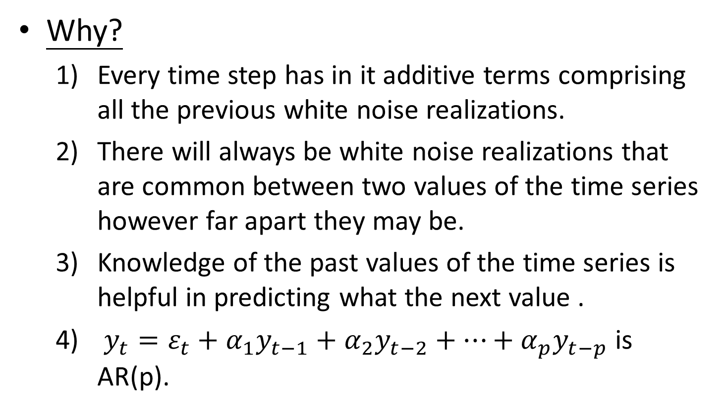
Time Series Model- AR
Why?
Every time step has in it additive terms comprising all the previous white noise realizations.
There will always be white noise realizations that are common between two values of the time series however far apart they may be.
Knowledge of the past values of the time series is helpful in predicting what the next value .
$y_{t}=ε_{t}+α_{1}y_{t−1}+α_{2}y_{t−2}+…+α_{p}y_{t−p}$ is AR(p).

Slide 20
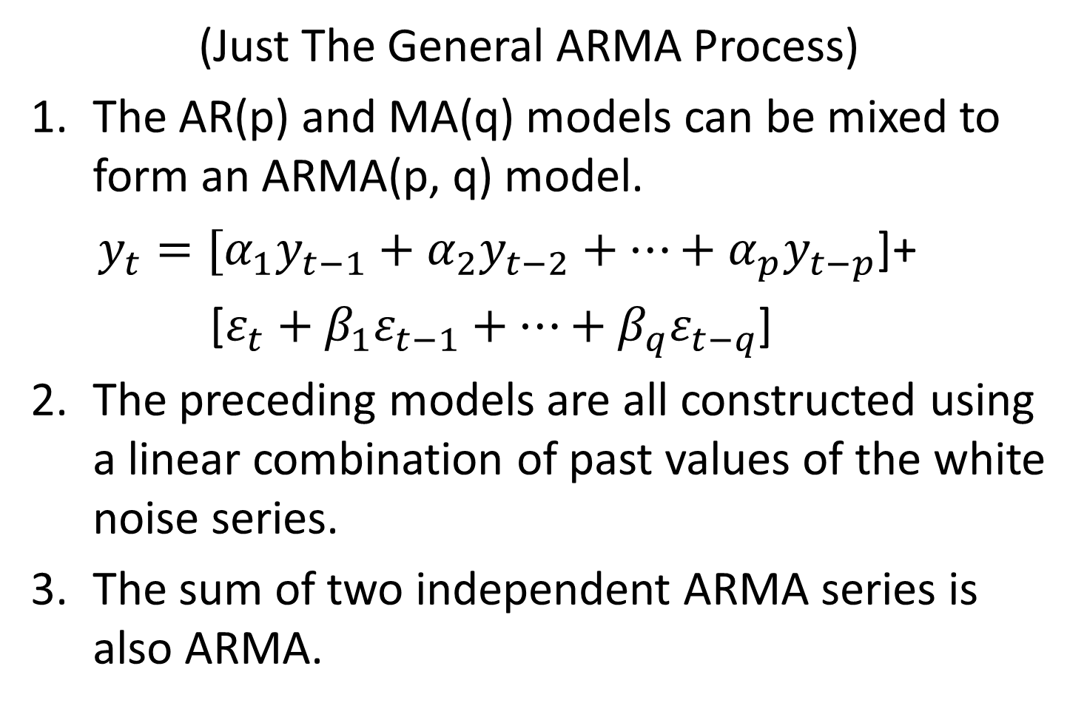
Time Series Model- ARMA
(Just The General ARMA Process)
The AR(p) and MA(q) models can be mixed to form an ARMA(p, q) model.
$y_{t}=[α_{1}y_{t−1}+α_{2}y_{t−2}+…+α_{p}y_{t−p}$]+
[$ε_{t}+β_{1}ε_{t−1}+…+β_{q}ε_{t−q}$]
The preceding models are all constructed using a linear combination of past values of the white noise series.
The sum of two independent ARMA series is also ARMA.

Slide 21
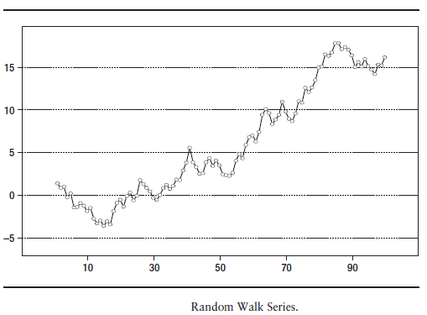

The Random Walk Process
A random walk is an AR(1) series with $α$ = 1.
From the definition of an AR series given, the
value of the time series at time t :
$y_{t}=ε_{t}+ε_{t−1}+ε_{t−2}+…=ε_{t}+y_{t−1}$

Slide 22
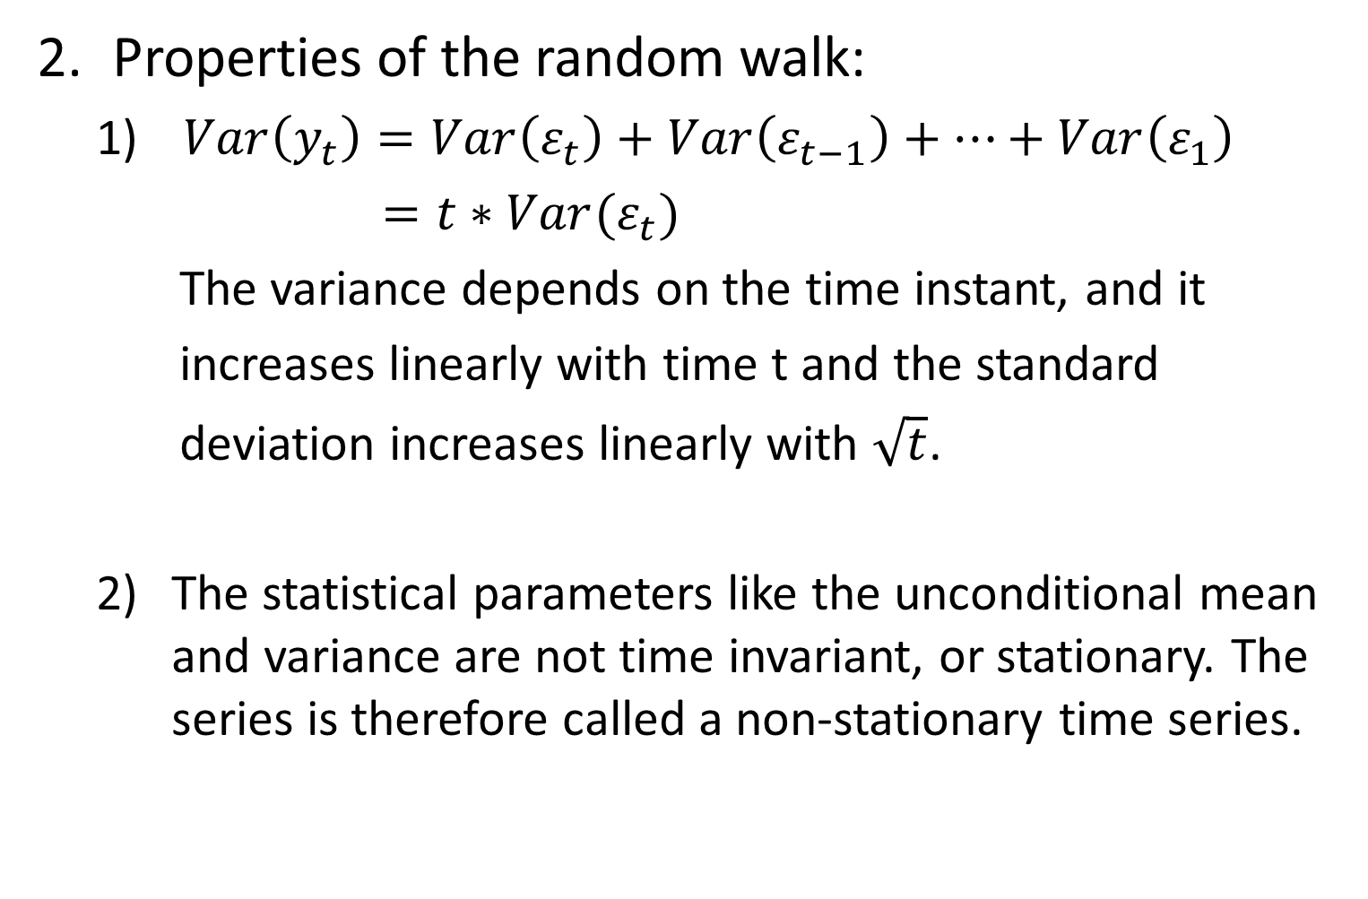
The Random Walk Process
Properties of the random walk:
$Var\left(y_{t}\right)=Var\left(ε_{t}\right)+Var\left(ε_{t−1}\right)+…+Var\left(ε_{1}\right)$
$=t∗Var(ε_{t})$
The variance depends on the time instant, and it
increases linearly with time t and the standard
deviation increases linearly with $\sqrt{t}$.
The statistical parameters like the unconditional mean and variance are not time invariant, or stationary. The series is therefore called a non-stationary time series.

Slide 23
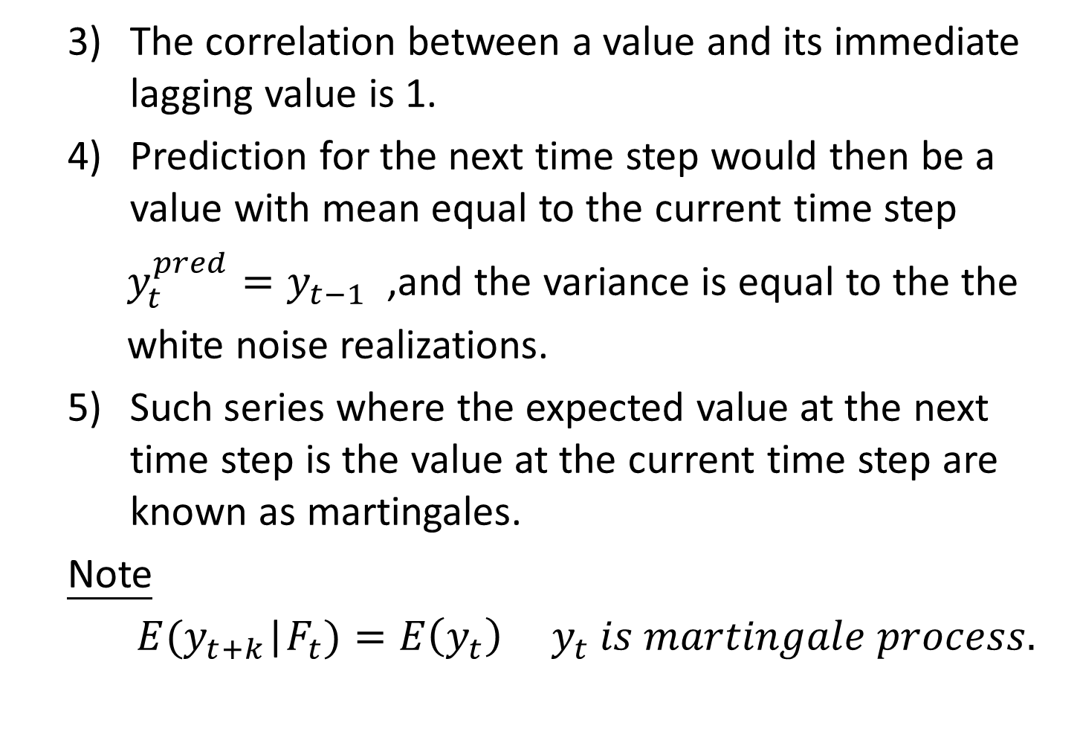
The Random Walk Process
The correlation between a value and its immediate lagging value is 1.
Prediction for the next time step would then be a value with mean equal to the current time step
$y_{t}^{pred}=y_{t−1}$ ,and the variance is equal to the the
white noise realizations.
Such series where the expected value at the next time step is the value at the current time step are known as martingales.
Note
$E(y_{t+k}$|$F_{t})=E\left(y_{t}\right) y_{t} is martingale process.$

